Slide 1


Slide 2
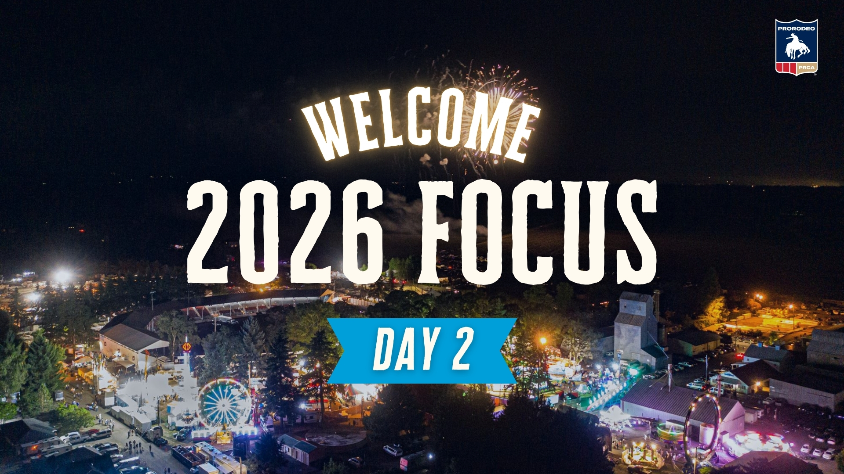
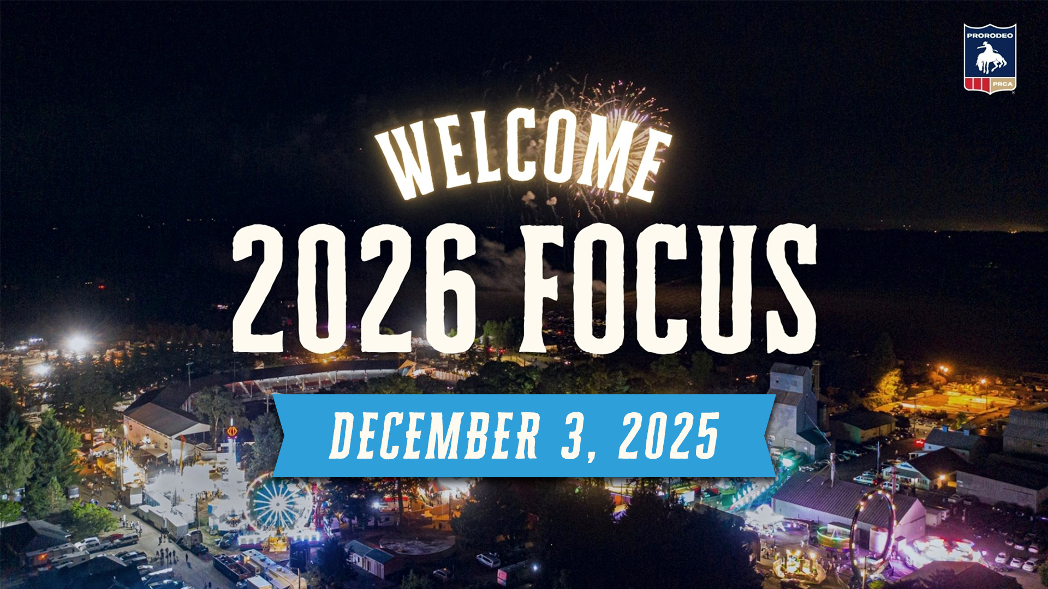

Slide 3
TOM GLAUSE
CEO

Slide 4
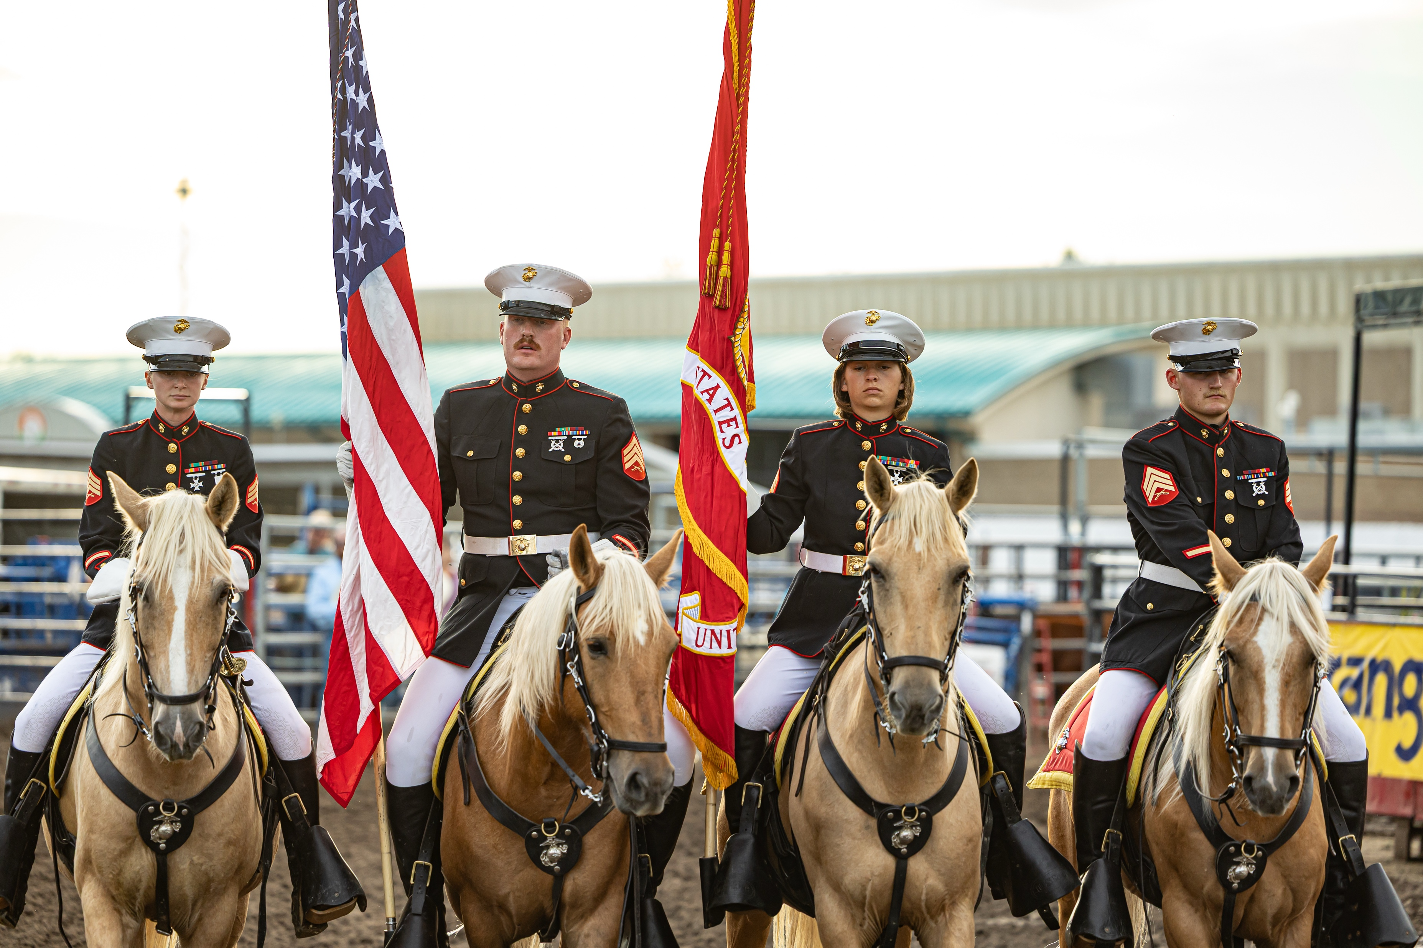

Slide 5
RODEO ADMINISTRATION

Slide 6
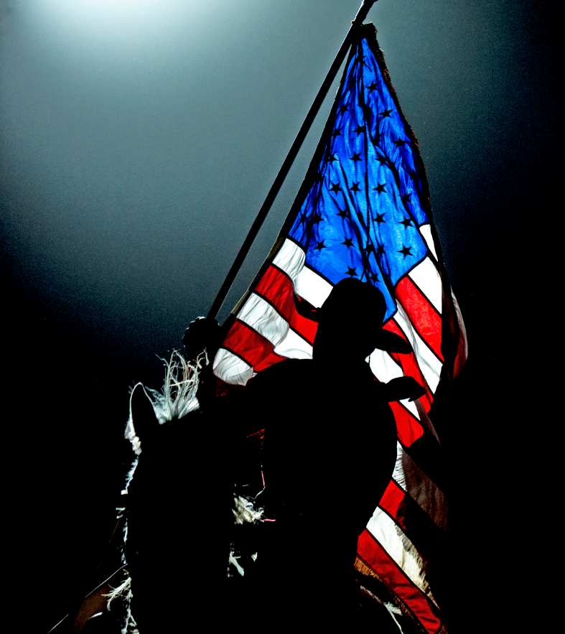
2025 SUMMARY
Increased approved events
Increased entries
Increased permits
Increased total payout

Slide 7
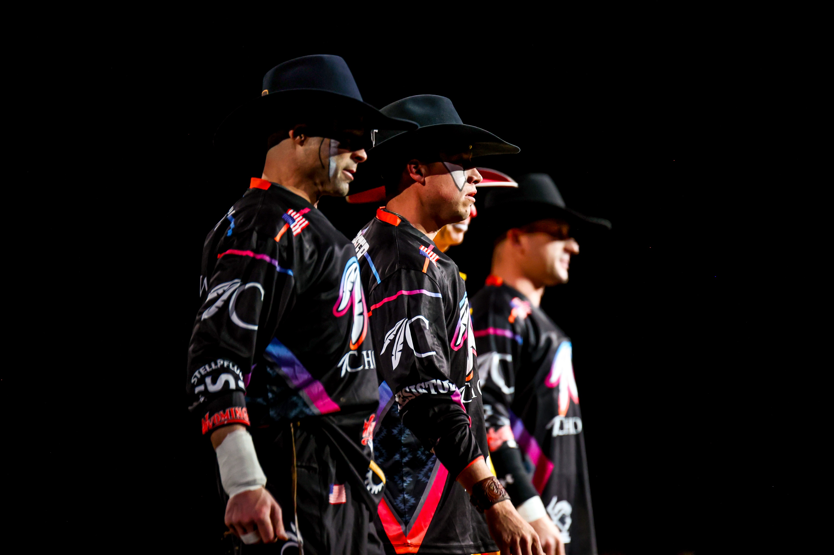
2026 FOCUS
Continued focus on expanding membership
Create more membership opportunities
Enhance opportunities for permits and rookies

Slide 8

2026 FOCUS
PLAYOFF SERIES LIST
Odessa, TX
Denver, CO
Fort Worth, TX
San Angelo, TX
Jackson, MS
San Antonio, TX
Tucson, AZ
Houston, TX
Austin, TX
Logandale, NV
Red Bluff, CA
Clovis, CA
Guymon, OK
Redding, CA
Nashville, TN
Woodward, OK
Sisters, OR
Vernal, UT
Reno, NV
Elko, NV
Prineville, OR
Springdale, AR
Pecos, TX
Greeley, CO
Prescott, AZ
Cody, WY
Livingston, MT
St Paul, OR
Mandan, ND
Oakley City, UT
Basin City, WA
Estes Park, CO
Casper, WY
Sheridan, WY
Nampa, ID
Salinas, CA
Cheyenne, WY
Ogden, UT
Spanish Fork, UT
Salt Lake City, UT
Deadwood, SD
Dodge City, KS
Heber City, UT
Castle Rock, CO
Sikeston, MO
Hermiston, OR
Lovington, NM
Logan, UT
Caldwell, ID
Canby, OR
Gooding, ID
Moses Lake, WA
Kennewick, WA
Tremonton, UT
Bremerton, WA
Ellensburg, WA
Walla Walla, WA
Lewiston, ID
Pendleton, OR
Mandan, ND
  CINCH PLAYOFFS:
  Puyallup, WA
  Sioux Falls, SD
Notes:
New to the list are Sikeston, Estes Park, Springdale, Nashville & Elko.

Slide 9
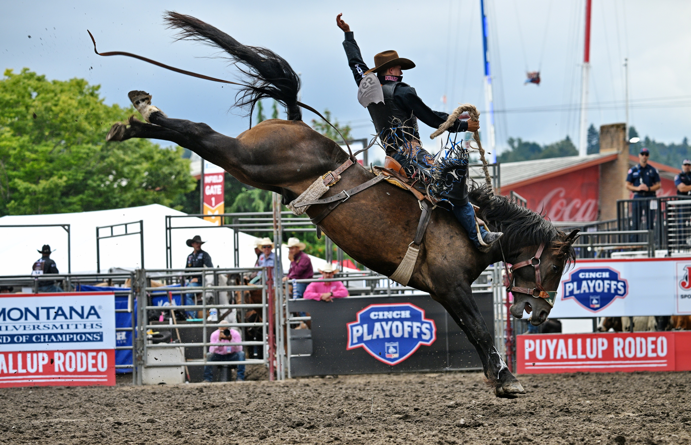
2026 FOCUS
CINCH PLAYOFFS
Wildcard Round
Puyallup, WA
Governor’s Cup
Sioux Falls, SD
$2,225,000 + Payout

Slide 10
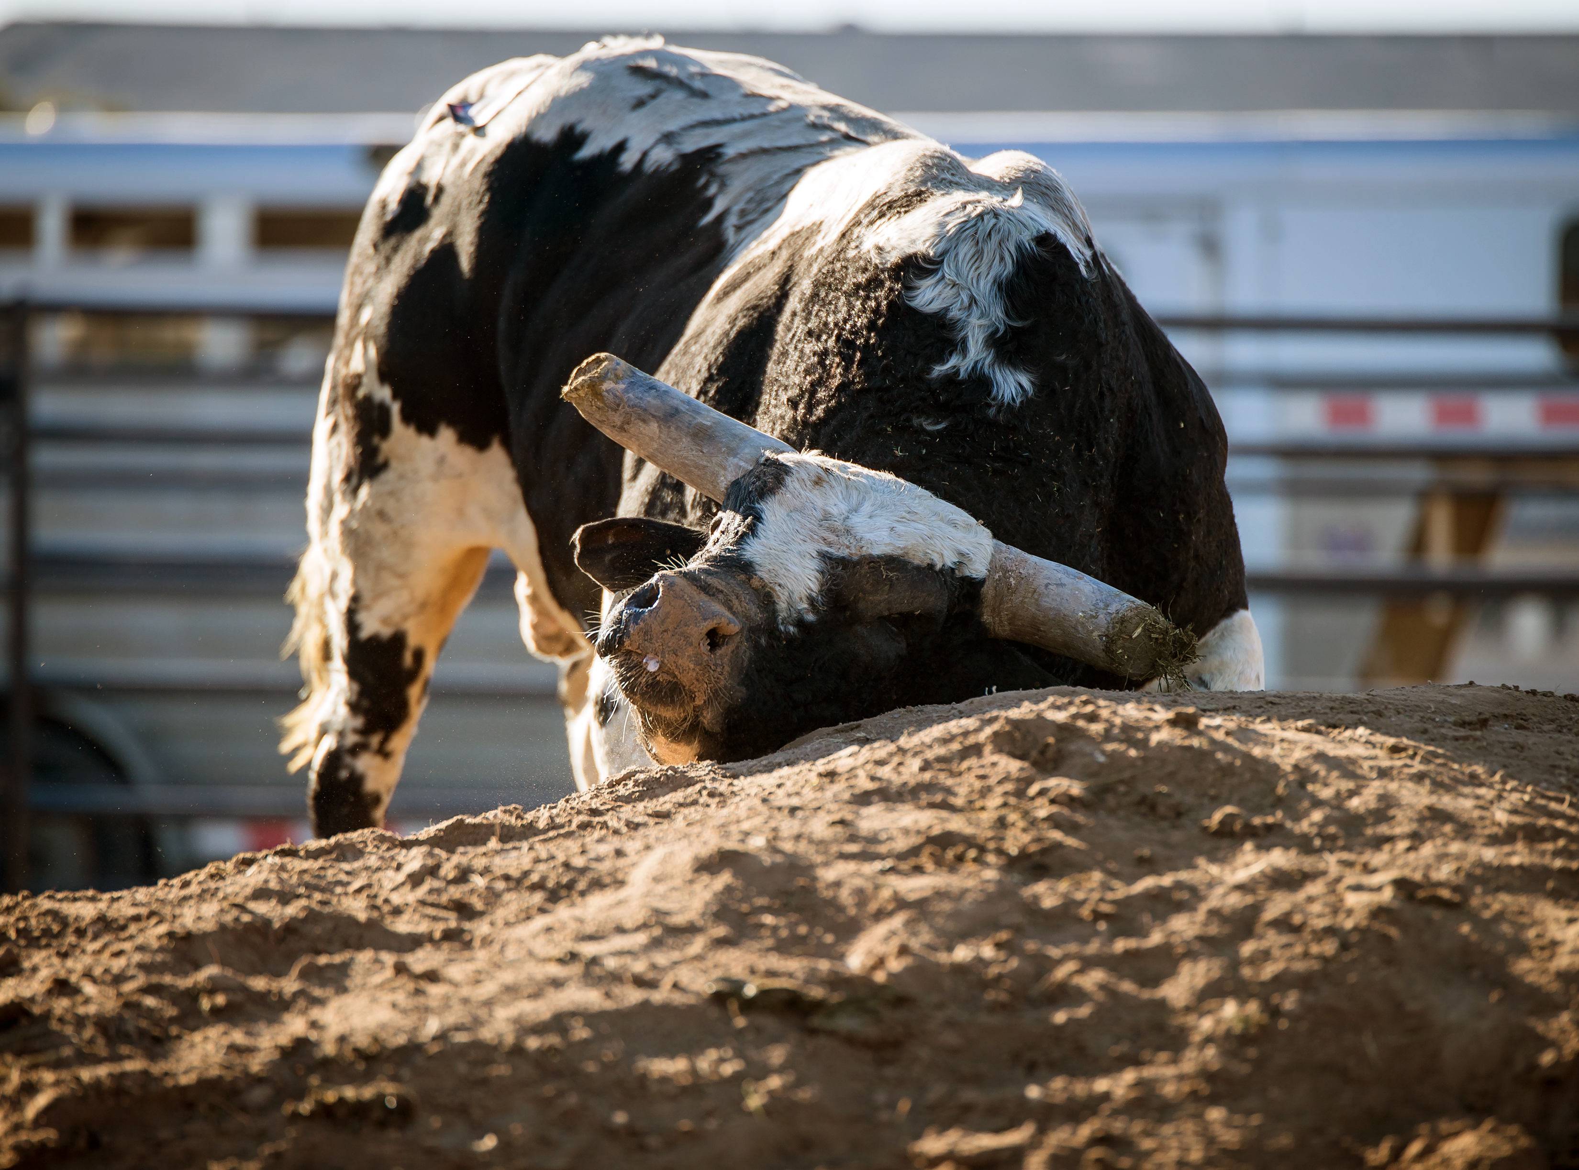
2026 FOCUS
LIVESTOCK WELFARE
Awareness of new and historical challenges
Continue building relationships with other stakeholders
Adapting as necessary to livestock welfare issues

Slide 11
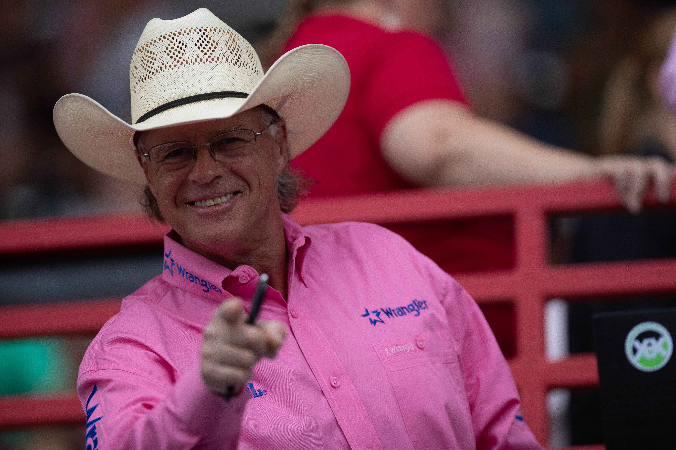
FIVE YEAR PROJECTION
7,500 members
Increase season payout to $90 Million
Reduce turnouts
Increase entries to 180,000

Slide 12
INFORMATION
TECHNOLOGY

Slide 13
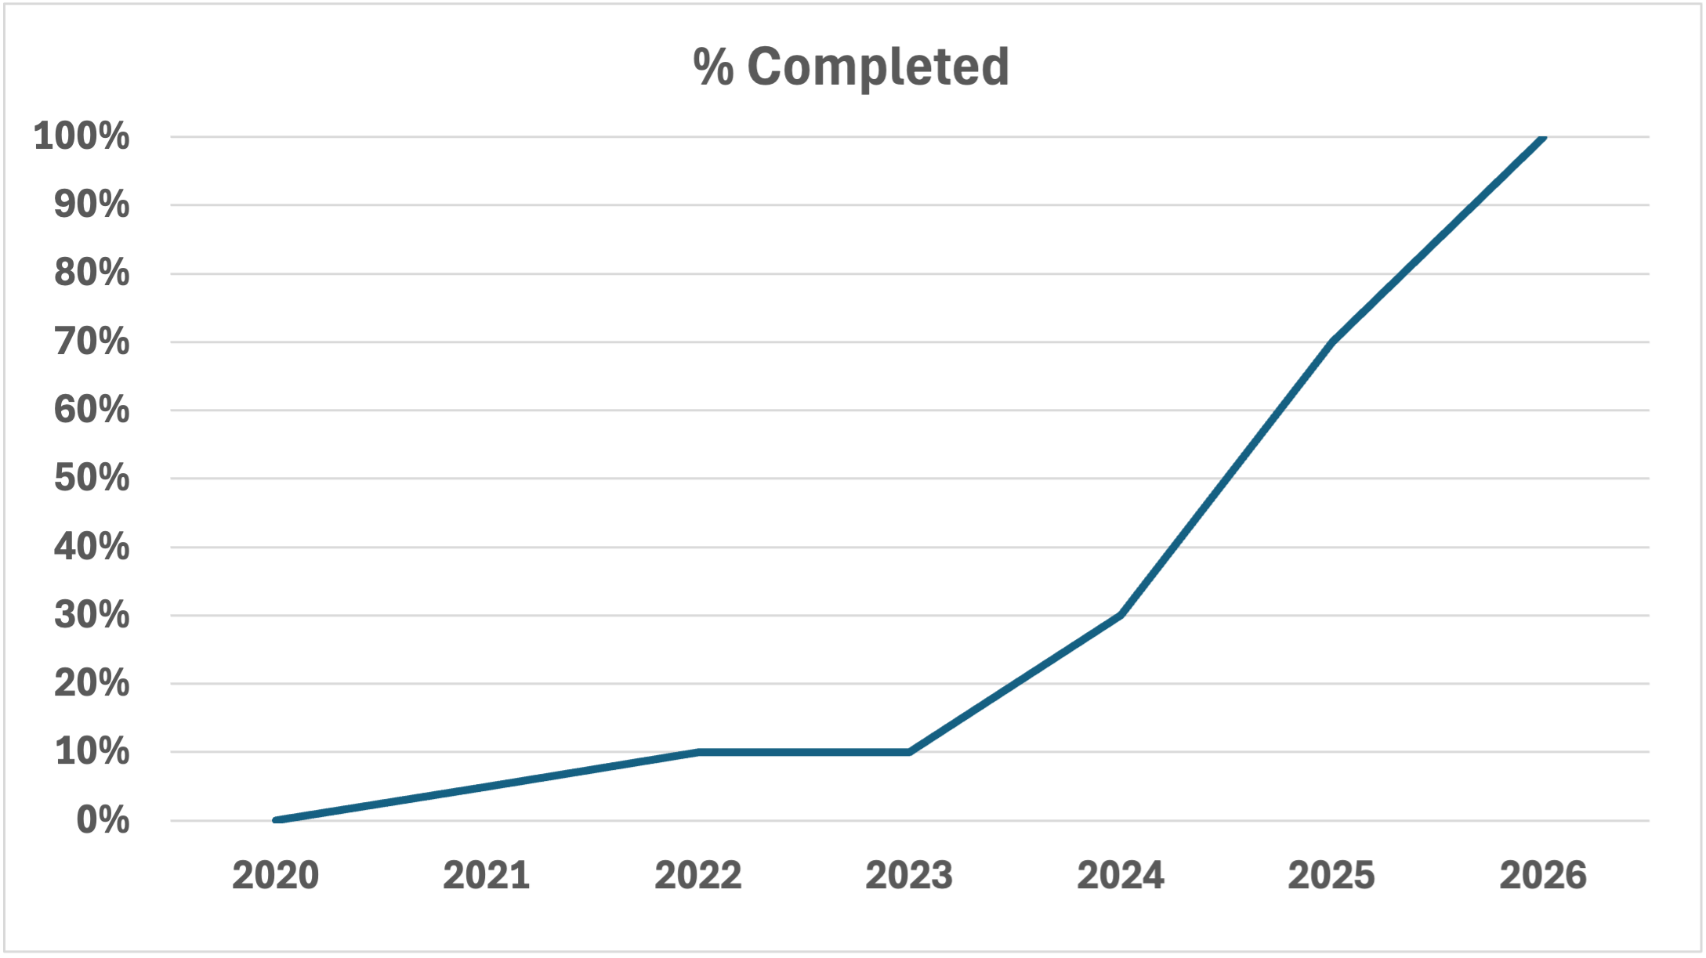
2026 FOCUS
AS/400 Migration
  Re-entries
  Replacements
  Alternate lists
  Trades
  Officials/Un-officials
  Standings
  Member Services

Slide 14

2026 FOCUS
Secretary System V3
  Focus on speed and stability
  Partnering with secretaries to set priorities
Artificial Intelligence (AI)
  Finding ways to use AI to improve efficiency and accuracy
  Leveraging AI to create contestant biographies

Slide 15
PRORODEO
HALL OF FAME

Slide 16

2025 SUMMARY
$250,000 raised at induction celebration
Contributor to the Ronald Reagan Library Cowboys Exhibit
PRHOF rodeo committee banner display
Three new PRHOF partners
  Tractor Supply
  PROHATS
  Runyon’s Fine Furniture

Slide 17
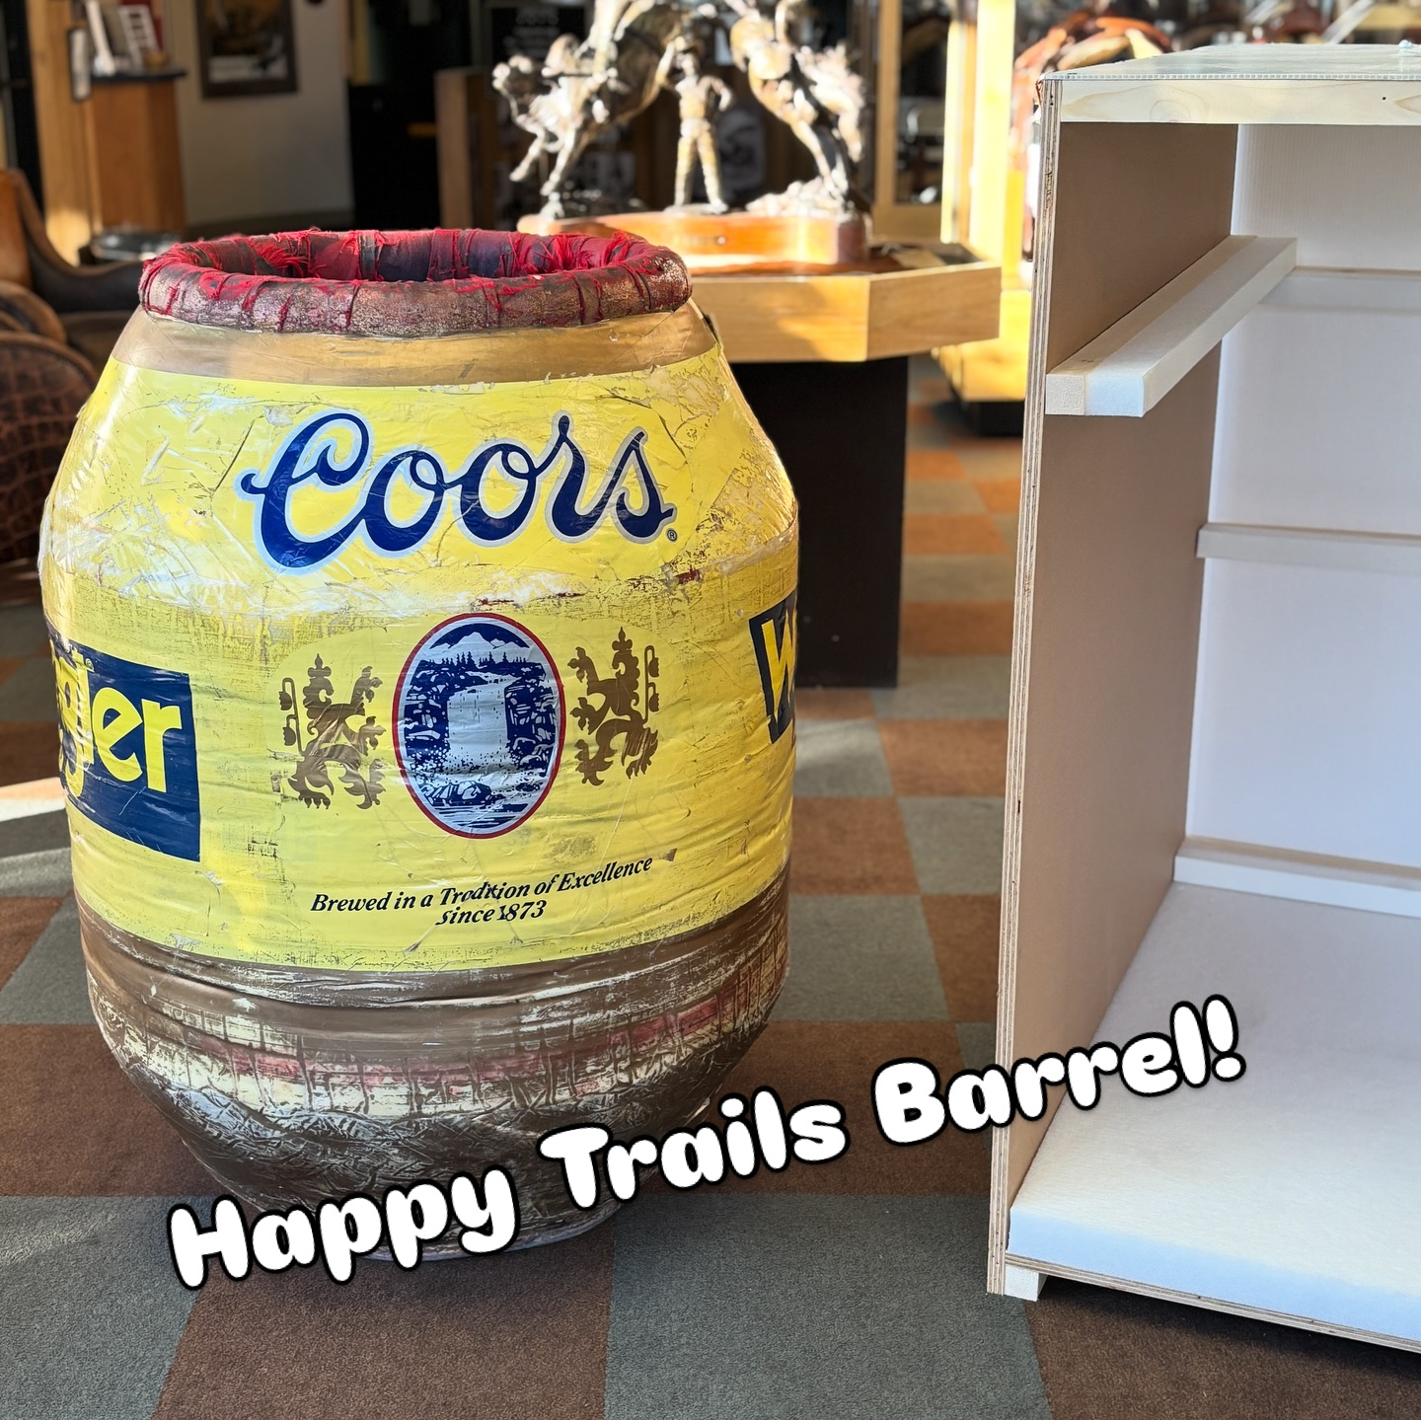
2026 FOCUS
New revenue streams
PRHOF website re-design
  Bring in-house
  Improve look & functionality
Gift shop
2026 Induction July 16-18

Slide 18
FINANCE

Slide 19
2025 PROJECTED
CONSOLIDATED REVENUE TREND ($ IN MILLIONS)

Slide 20
2026 BUDGET

Slide 21
FIVE-YEAR BUDGET
CONSOLIDATED REVENUE TREND ($ IN MILLIONS)

Slide 22
COMMUNICATIONS & MARKETING

Slide 23



MARKETING
America 250
  More than 38 states
  Committees can support with event messaging or social media
Celebration of 90th Anniversary
PRORODEO x PRCA Branding

Slide 24


DIGITAL & BROADCAST
Increase video activation at all sizes of rodeos
Continue collaboration with rodeo committees
Improving quality of production for broadcast
Inspiring new audiences
Authentic re-telling of history

Slide 25
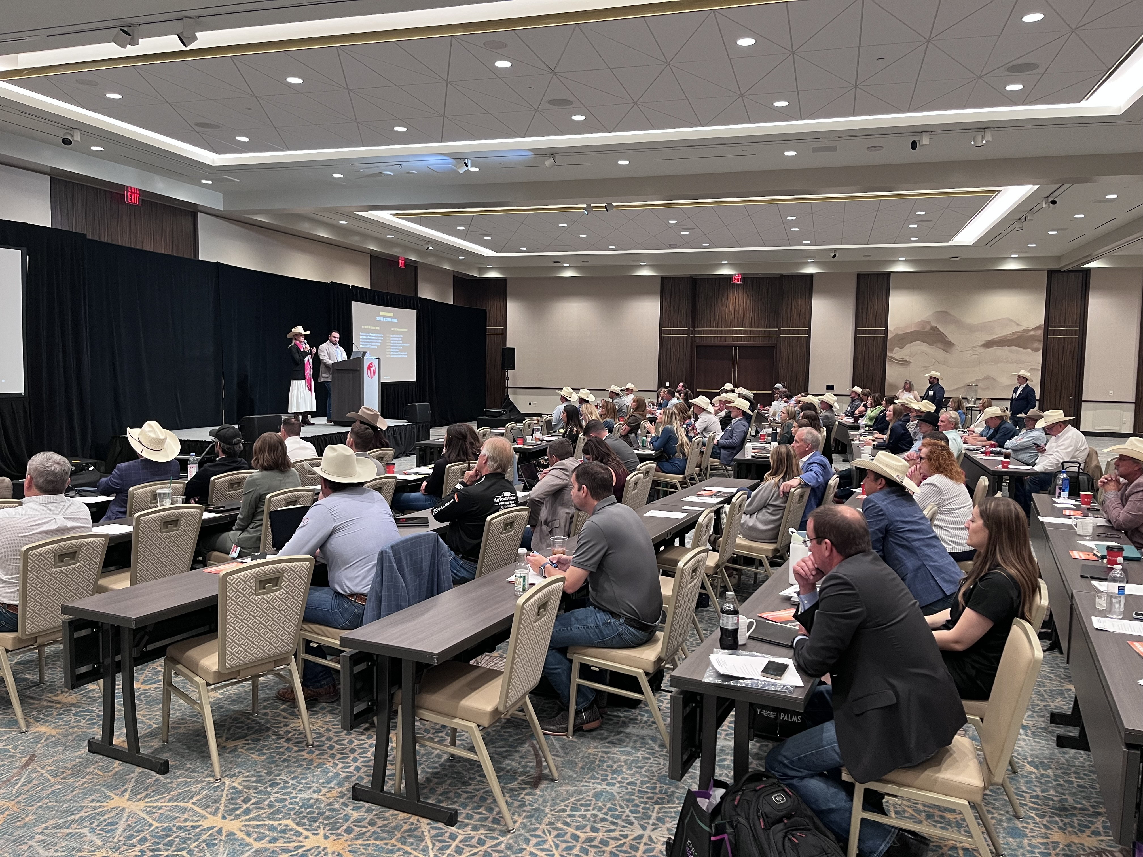
PARTNERSHIPS
Expand revenue year-over-year (sponsorship, licensing, merchandising)
Strengthen committee collaboration and business development
Enhance data-driven sales and partner reporting
Non-endemic brand and agency outreach

Slide 26
THANK YOU

