Slide 1


Slide 2
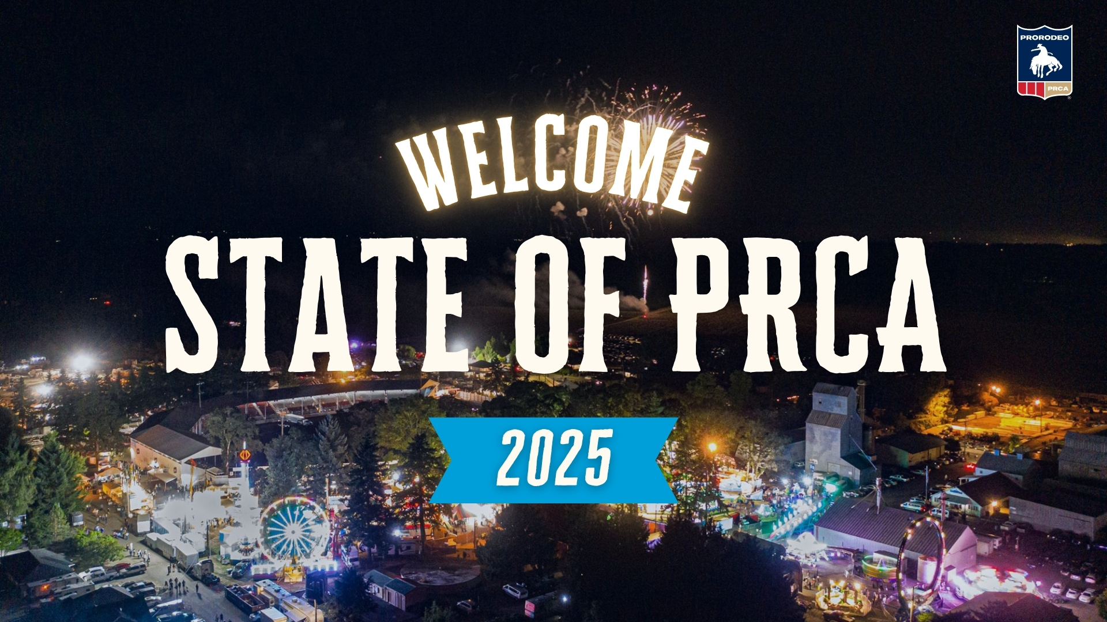
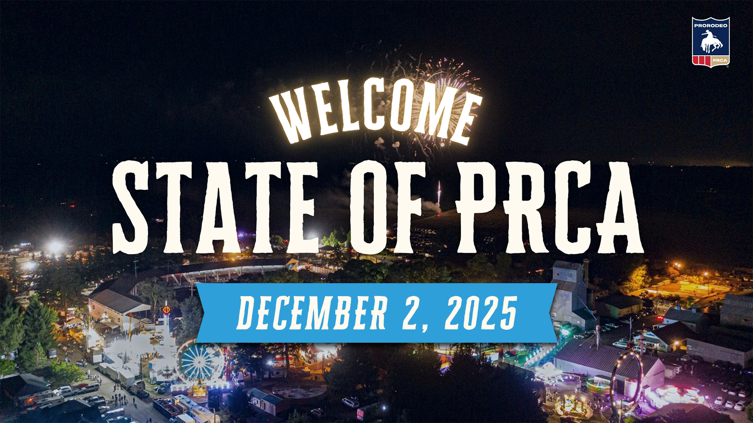

Slide 3
TOM GLAUSE
CEO

Slide 4
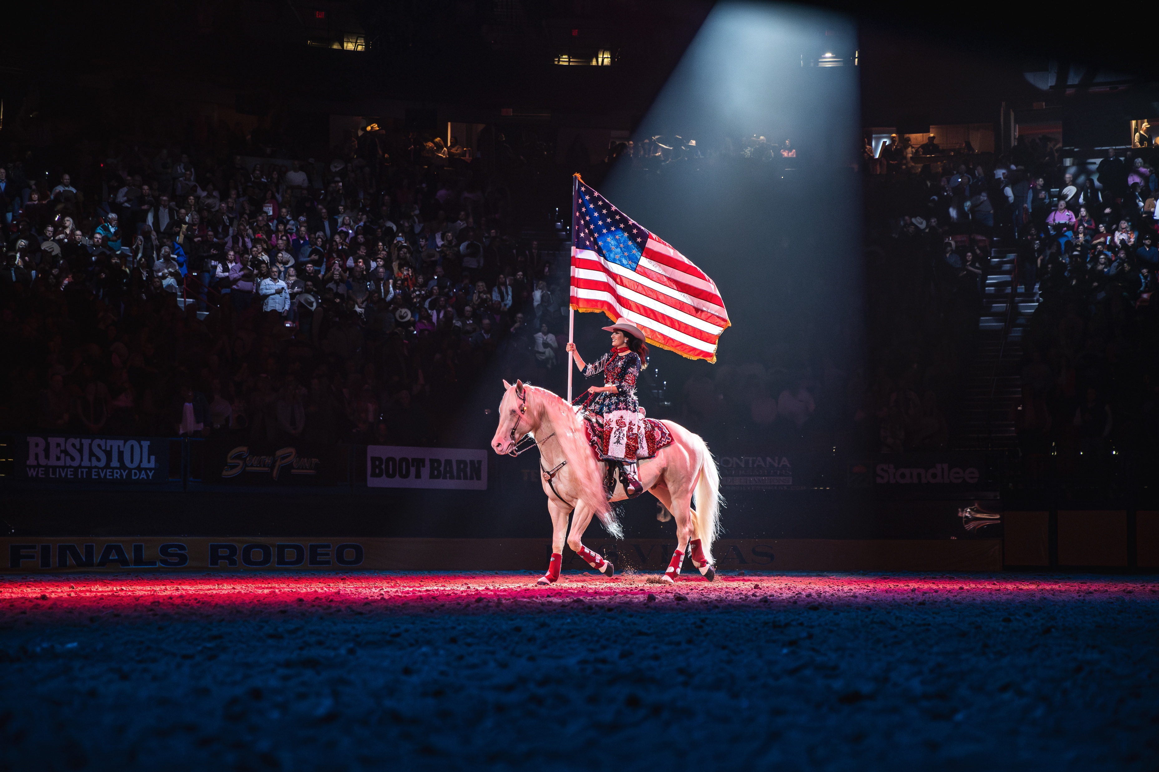

Slide 5
RODEO ADMINISTRATION

Slide 6
MEMBERSHIP 2023-2025

Slide 7
CONTESTANT NUMBERS 2025

Slide 8
PERMITS/ROOKIES LOOKING TO THE FUTURE

Slide 9
RODEO ENTRIES

Slide 10
RODEO BY THE NUMBERS

Slide 11
RODEO BY THE NUMBERS

Slide 12
TURNOUTS

Slide 13
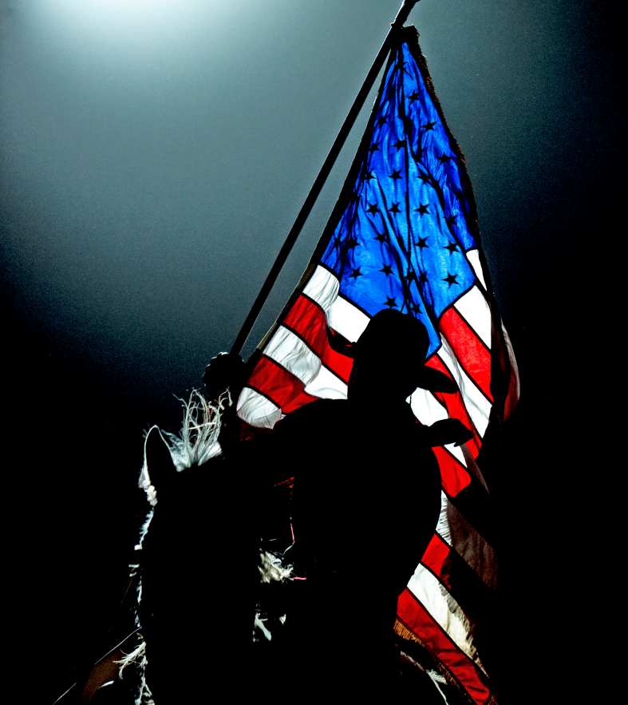
2025 SUMMARY
Increased approved events
Increased entries
Increased permits
Increased total payout

Slide 14
INFORMATION TECHNOLOGY

Slide 15
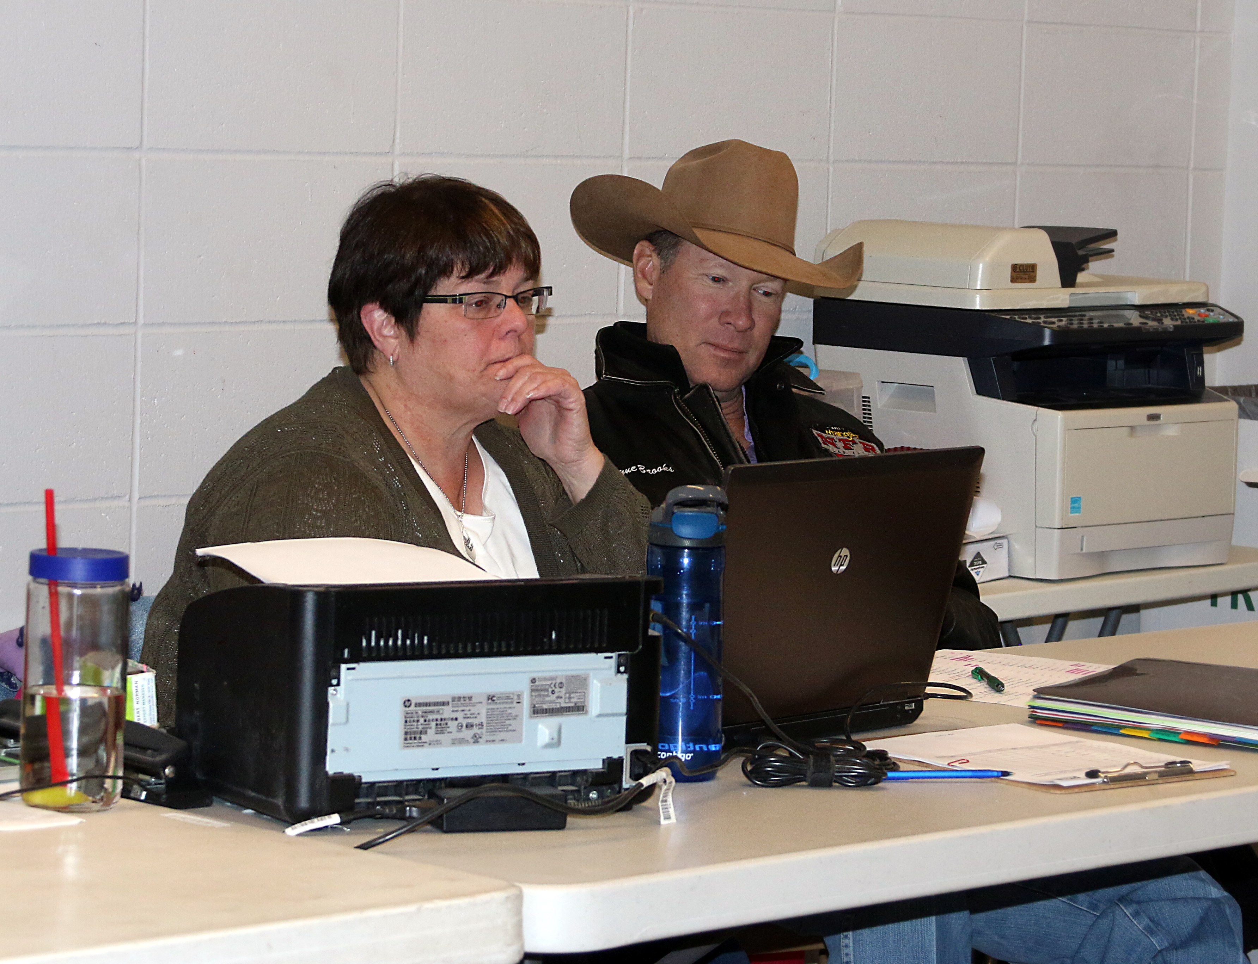
SECRECTARY SYSTEM V3
Addition of Application Support Technician
Challenging summer with significant progress
Upcoming Secretary training
Notes:
Day 1 Slide 1 – Secretary System V3
Welcomed Bradley Cole as a new support technician to assist Angela Maidt and Payden McIntyre
Had issues this summer with progressive rodeos and placing contestants in the correct order. Also had issues with handling team roping replacements. Both of those issues have been resolved.
We have had an online training session back in October. On Day 2 of convention we will have a live training session. We will continue to hold training sessions throughout the coming year.

Slide 16
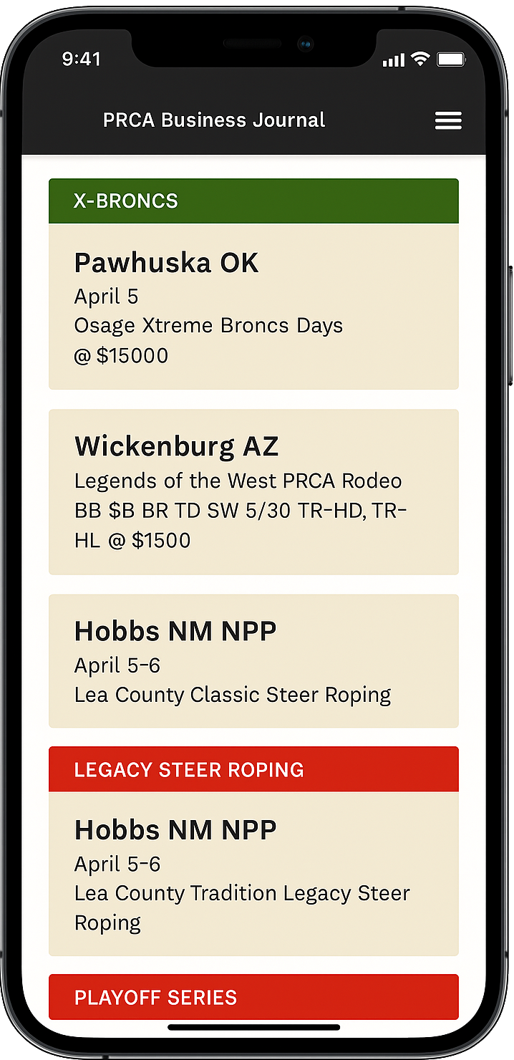
PROFESSIONAL BUSINESS JOURNAL
Launched a new online PBJ
Initial basic release with evolution
Combines ground rules and entry information
Provides more timely updates
Mobile-friendly for easy access

Slide 17

AS/400 MIGRATION
Items nearing completion
Stock management
Rodeo approvals
Judging
Qualifications
Items completed
Online doctor releases
Business Journal
Reporting

Slide 18
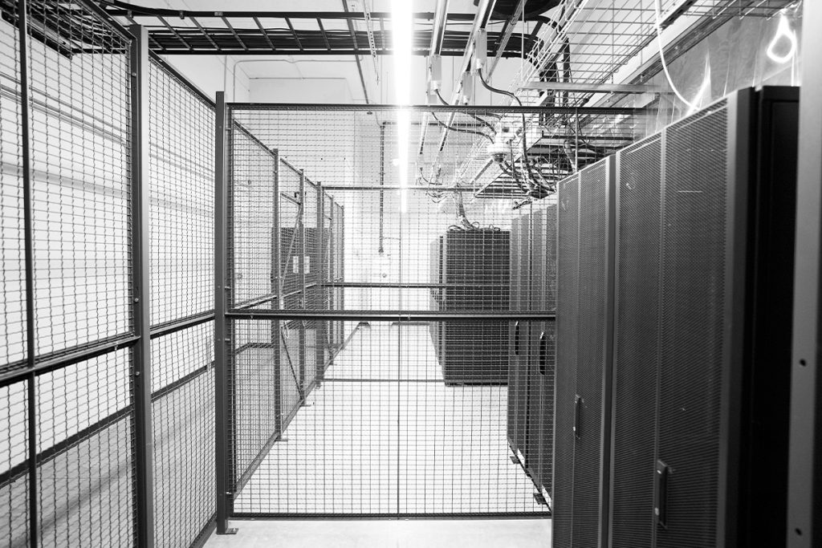
NEW DATA CENTER
Successfully moved to new facility
Built with security first in mind
Updated to the latest software and hardware
Scalable to grow with the PRCA

Slide 19
PRORODEO HALL OF FAME

Slide 20
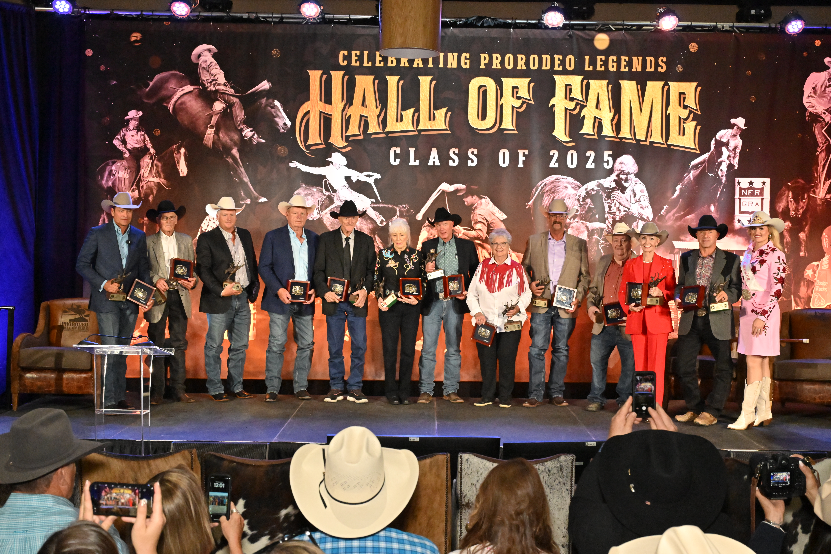
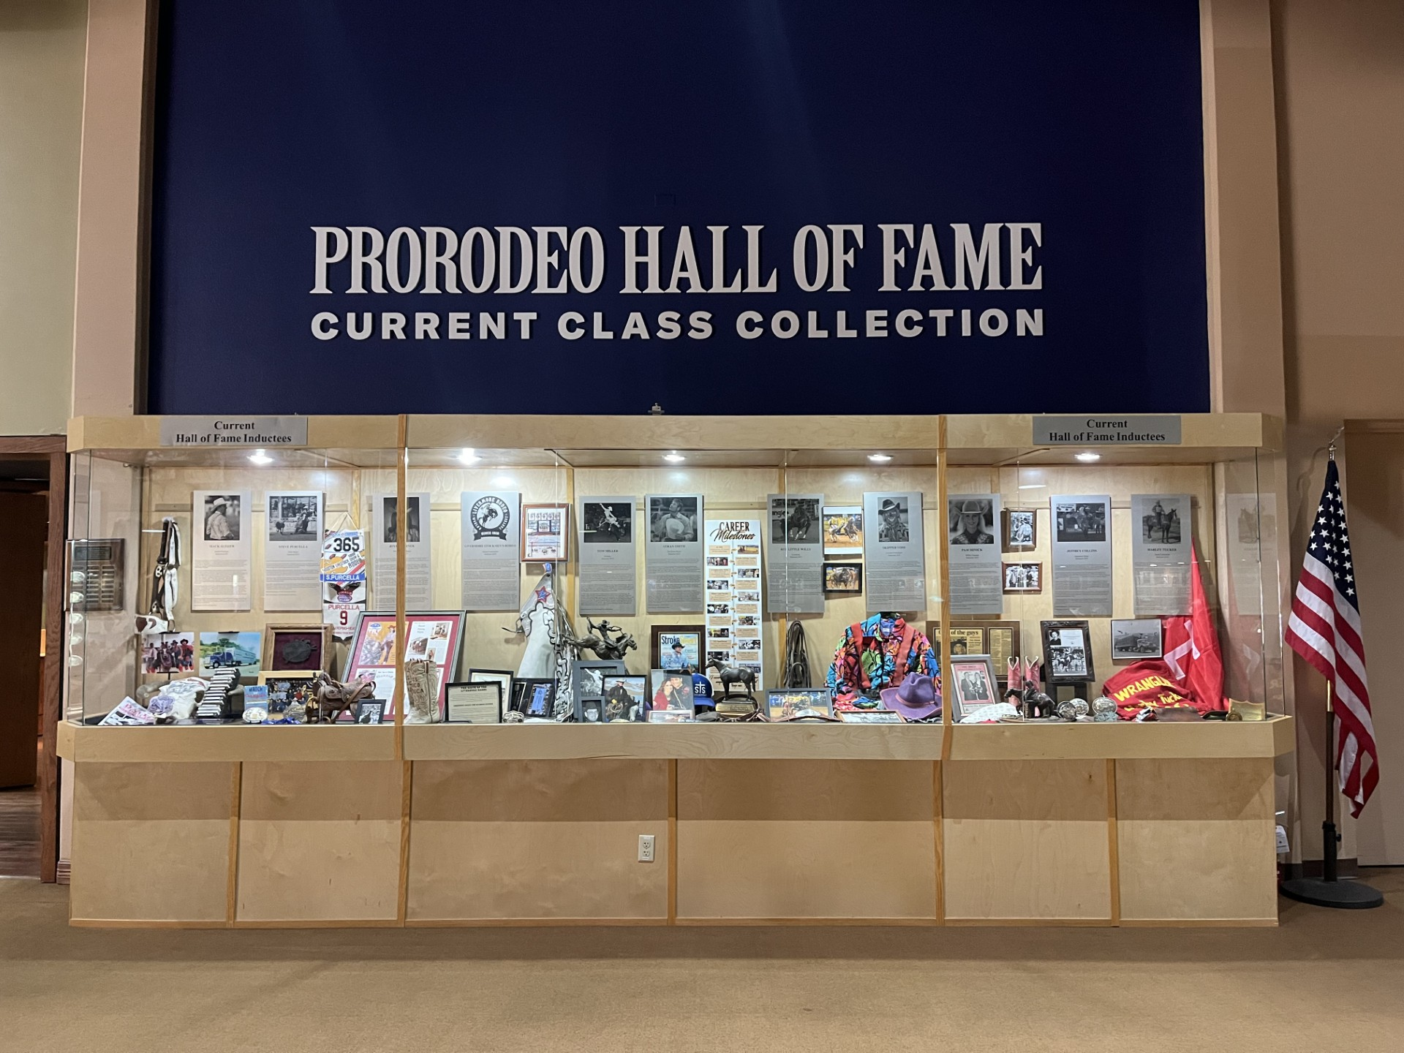
2025 INDUCTION CEREMONY
Class of 11 Inductees
Induction Revenue - $250,000
440 for the Cowboy Ball
549 for the Induction Ceremony
Upgraded the current inductee case

Slide 21
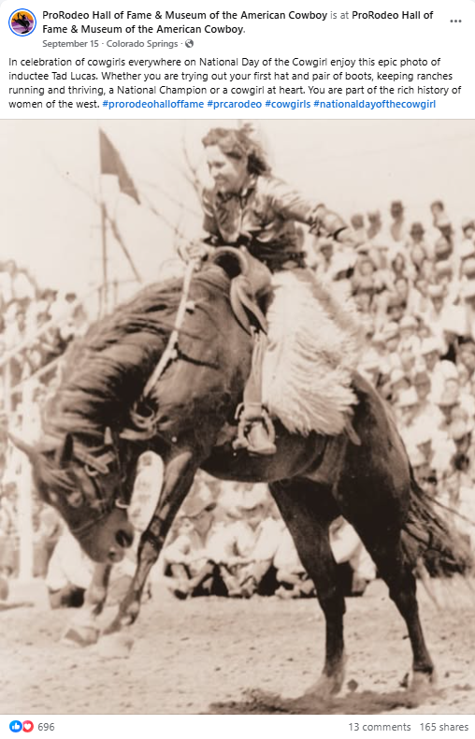
2025 HIGHLIGHTS
Hall of Fame through mid-November
12,269 paid admissions
$116,000 gift shop sales
Social Media Growth
Facebook: Interactions increased 111% over 2024
Instagram: Followers increased 9% since February

Slide 22

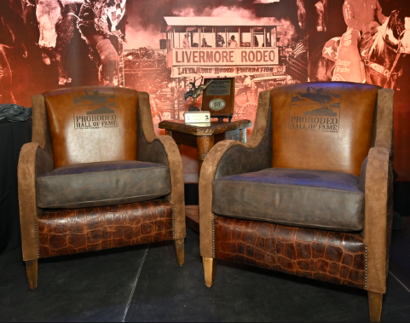
2025 HIGHLIGHTS
Contributor to the Ronald Reagan Library exhibit on Cowboys
Three New Partners
Tractor Supply
ProHats
Runyon’s Fine Furniture

Slide 23

NFR BANNER DISPLAY
New initiative for 2025 in partnership with Las Vegas Events
22 participating rodeo committees
Banners will be displayed on TMC concourse
Two-year commitment

Slide 24
NFR BANNER DISPLAY
Thank you to the committees that supported this new initiative:
Austin, TX
Caldwell, ID
Cheyenne, WY
Clovis, CA
Denver, CO
Dodge City, KS
Franklin, TN
Gunnison, CO
Lovington, NM
Ogden, UT
Pendleton, OR
Prescott, AZ
Red Bluff, CA
Redding, CA
Salt Lake, City
San Antonio, TX
Salinas, CA
Santa Barbara, CA
Santa Maria, CA
St. Paul, OR
Tucson, AZ
Uvalde, TX

Slide 25
FINANCE

Slide 26
2025 PROJECTED CONSOLIDATED REVENUE TREND ($ IN MILLIONS)

Slide 27
2025 PROJECTED

Slide 28
COMMUNICATIONS & MARKETING

Slide 29

COMMUNICATIONS
Revamped PRORODEO Sports News
Cover features
Stories over stats
Highlighting rodeos big and small
Digital PSN flexibility to include rodeo coverage/timely features
Use cross promotion of our stars with celebrities to promote PRORODEO
Chute Bosses weekly recaps

Slide 30
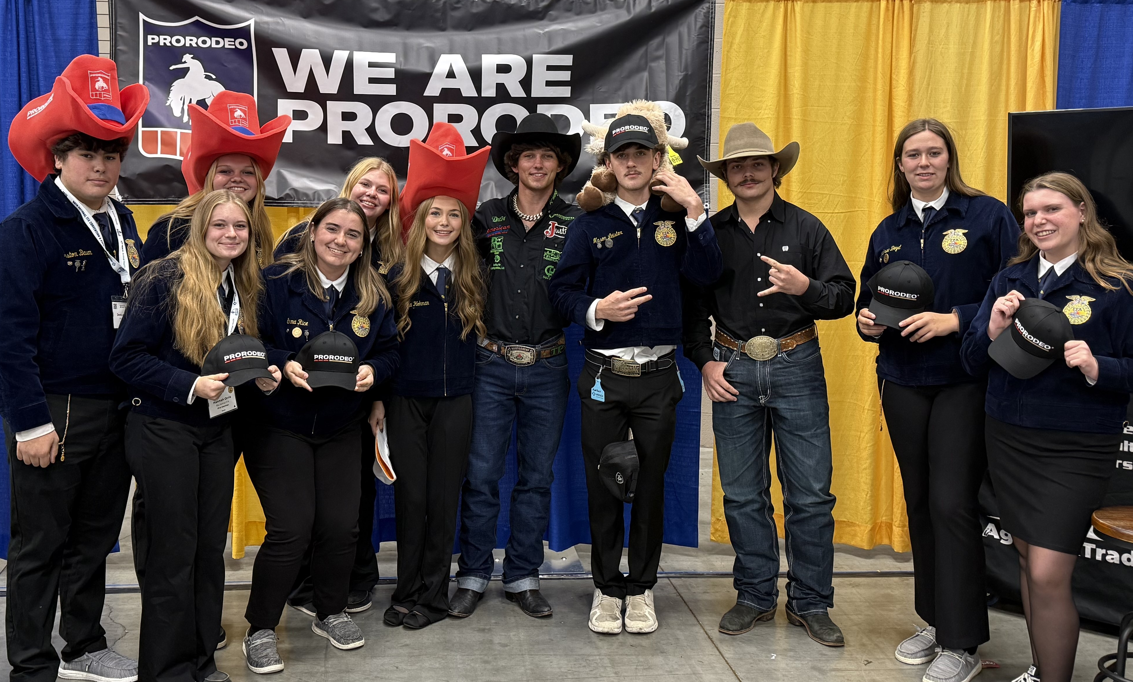
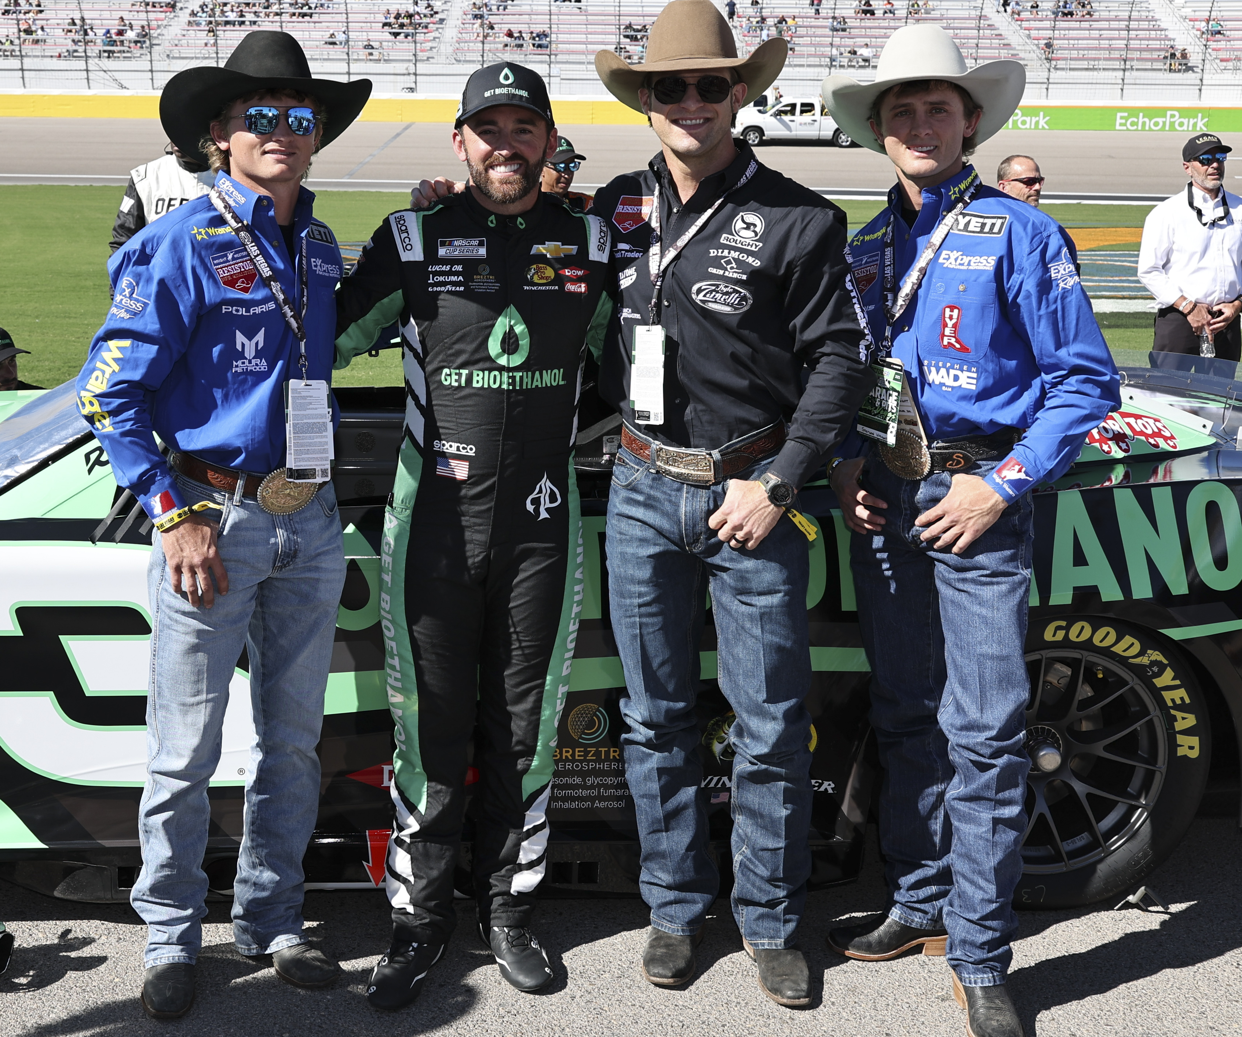
MARKETING
Continued elevation of our brand and athletes
FFA National Convention
Arizona Cardinals
NASCAR/RCR
PRORODEO Community Outreach
Newspaper ads & Promotion
NFR watch parties

Slide 31
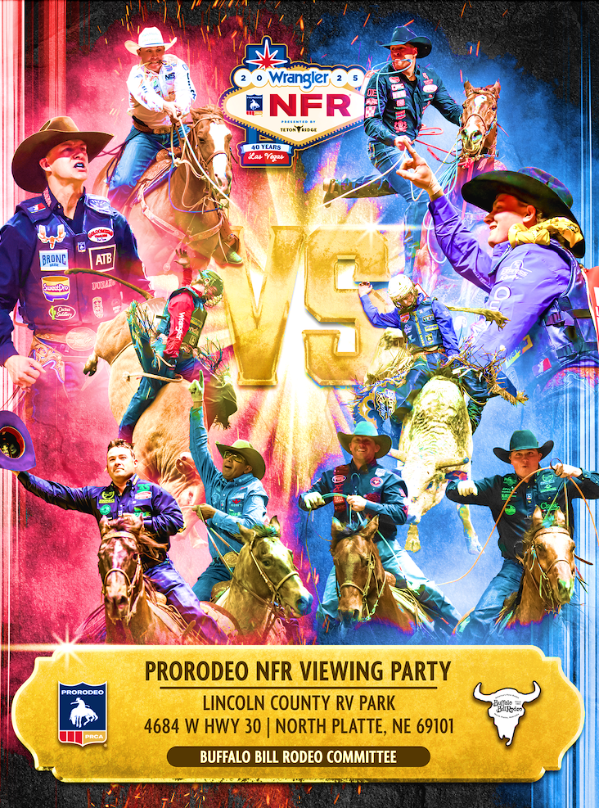
NFR WATCH PARTIES
Snake River / Caldwell Night Rodeo
Sitting Bull Stampede
Tri-State Rodeo
Clovis, CA
Southeastern Livestock Exposition
Cedar County (NE) PRCA Rodeo
Buffalo Bill Sheridan WYO Rodeo
Pendleton Roundup
Corn Palace Stampede
NFR Open at the Pikes Peak or Bust
Cle Elum Rodeo / Bares and Broncs

Slide 32
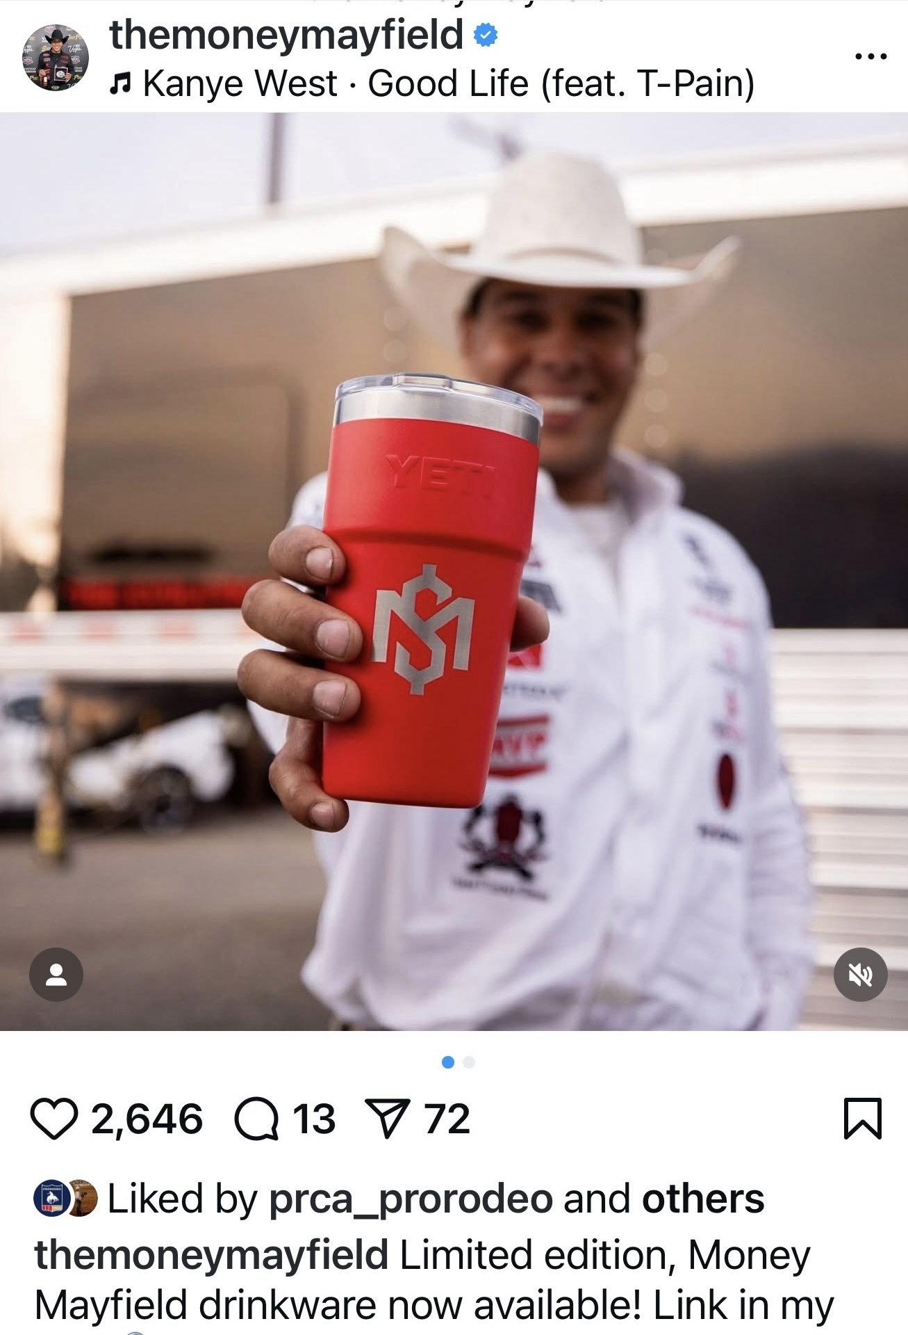
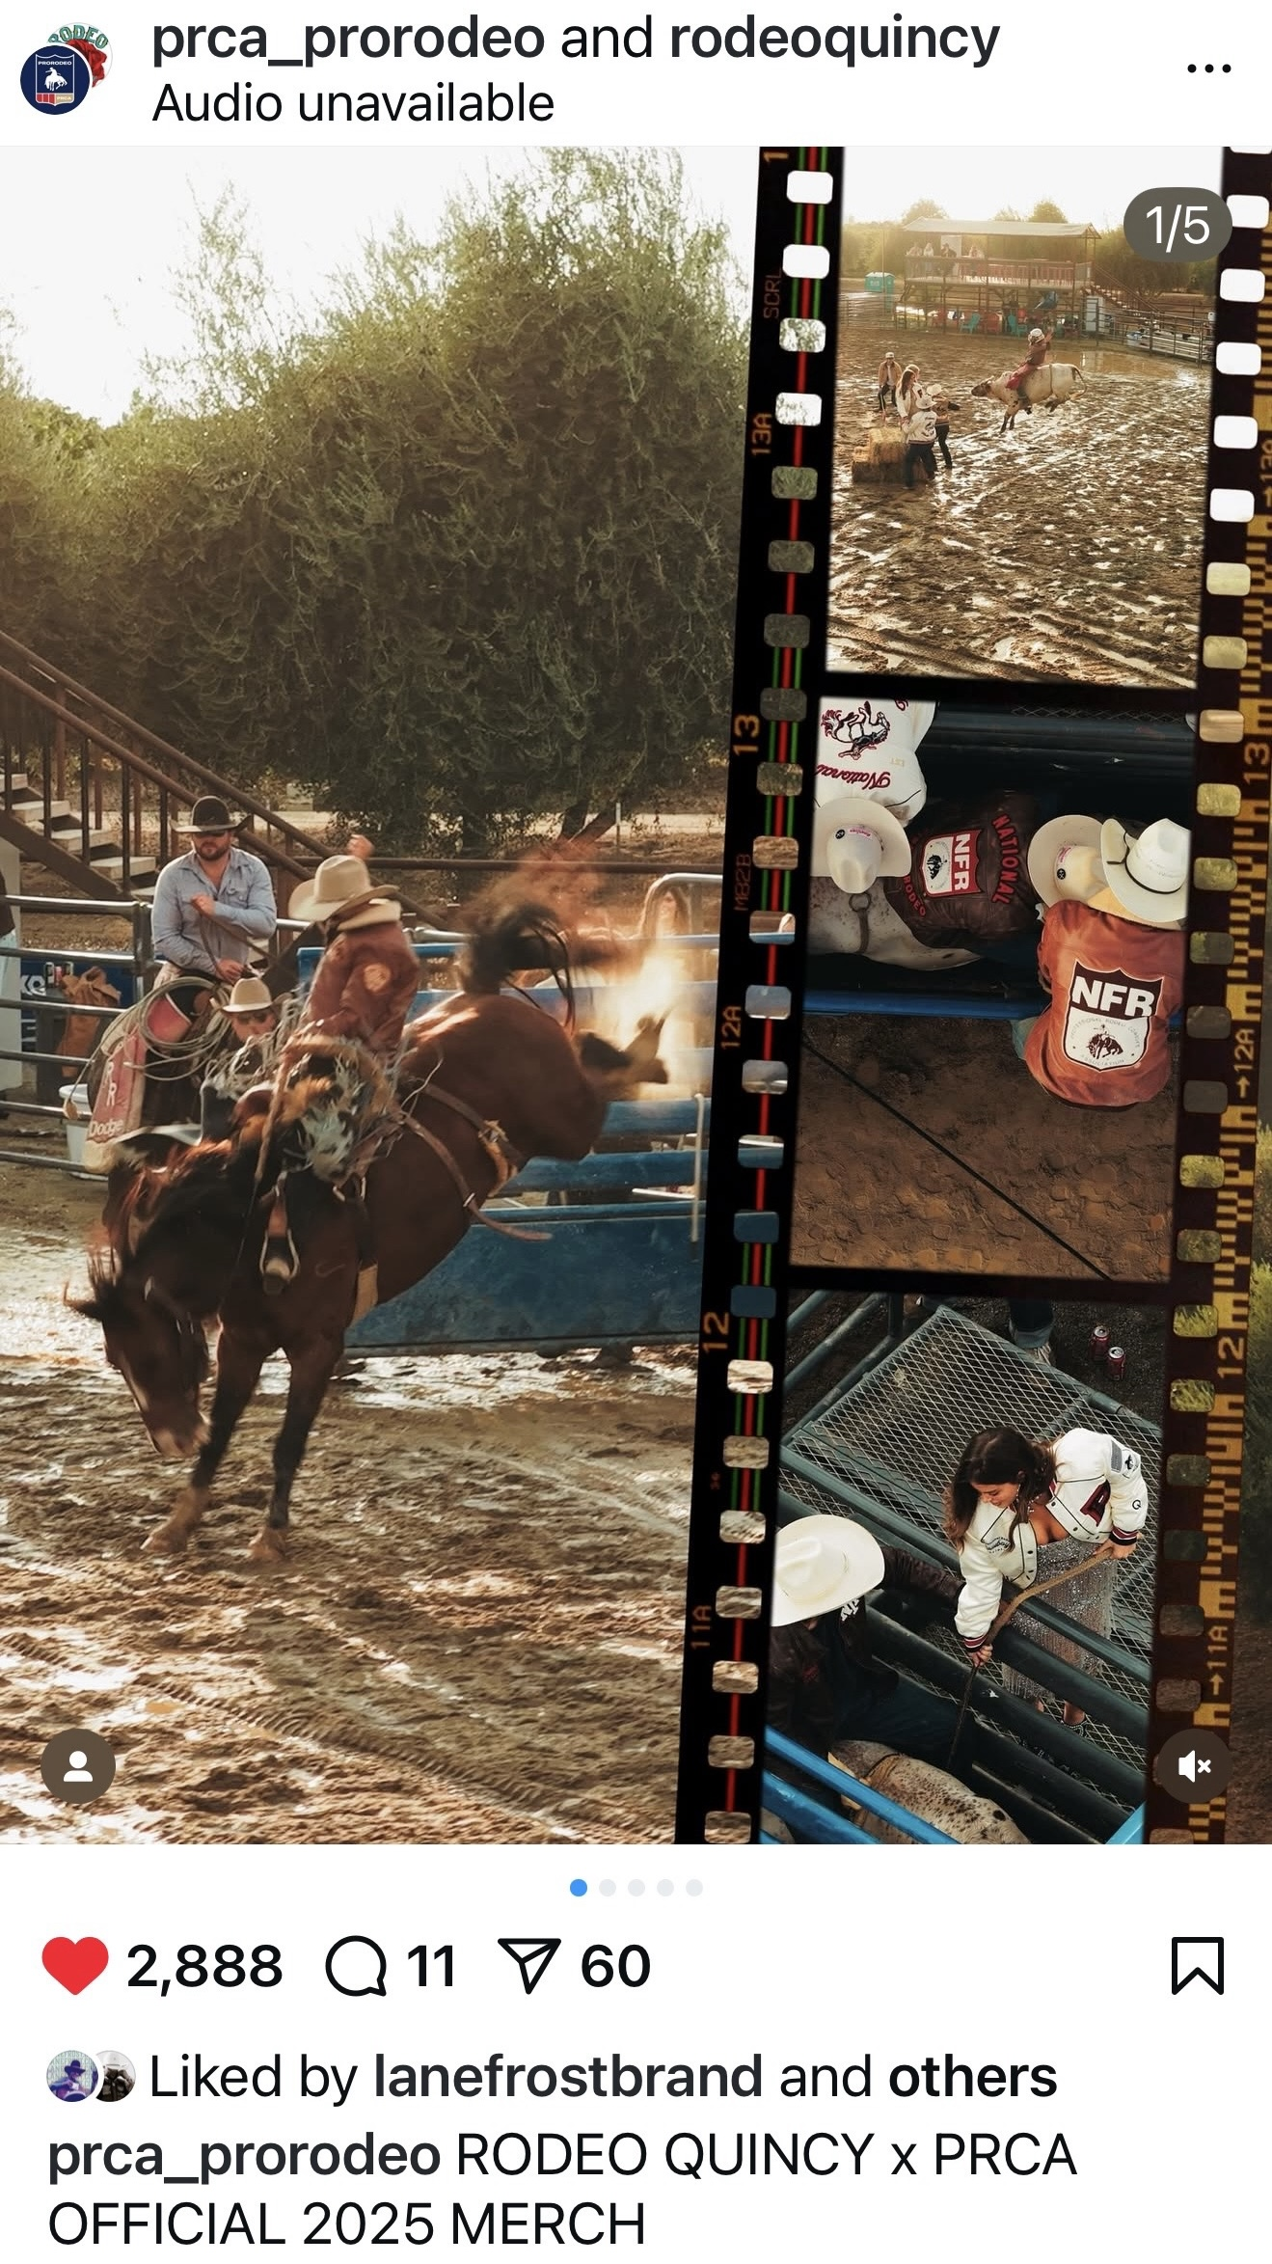
LICENSING AND RETAIL
Collaboration with Yeti and Athletes
Partnership with Rodeo Quincy continues to grow
Addition of new licensees expands reach of PRORODEO revenue opportunities

Slide 33
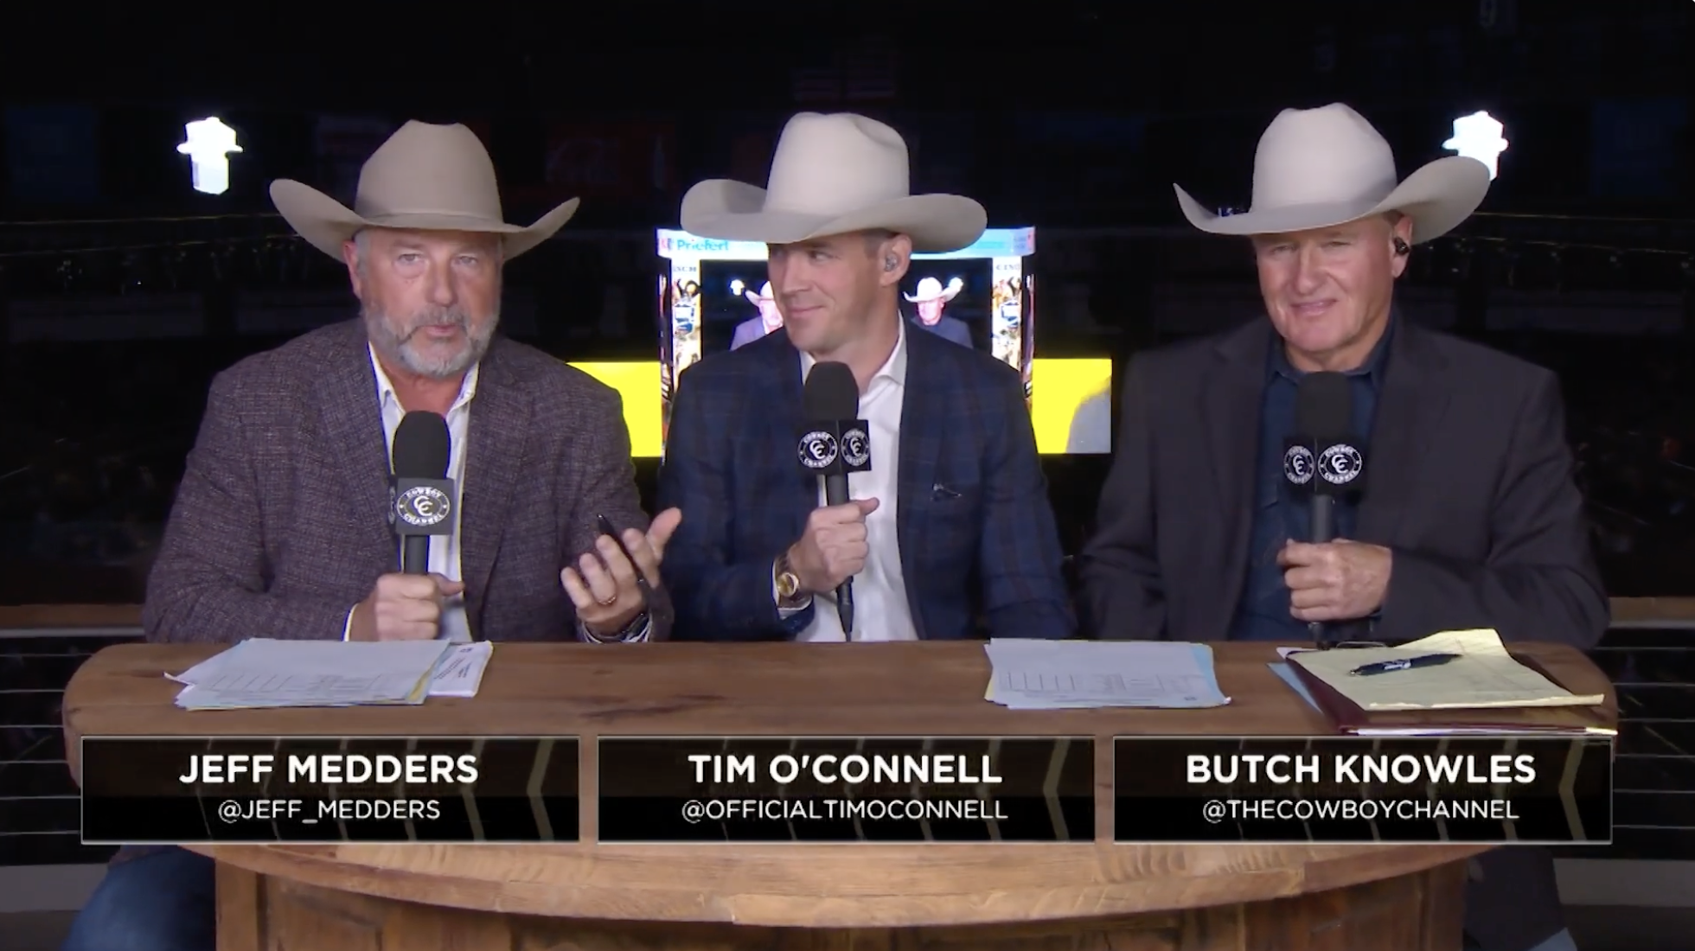

DIGITAL & BROADCAST
Teton Ridge ownership of The Cowboy Channel
PRCA emphasis on video content
Series development
Change in social voice

Slide 34


PARTNERSHIPS
XBulls & XBroncs title sponsor delivering money directly to committees
Boot Barn Circuit Finals
Acumatica supporting Circuit Finals

Slide 35
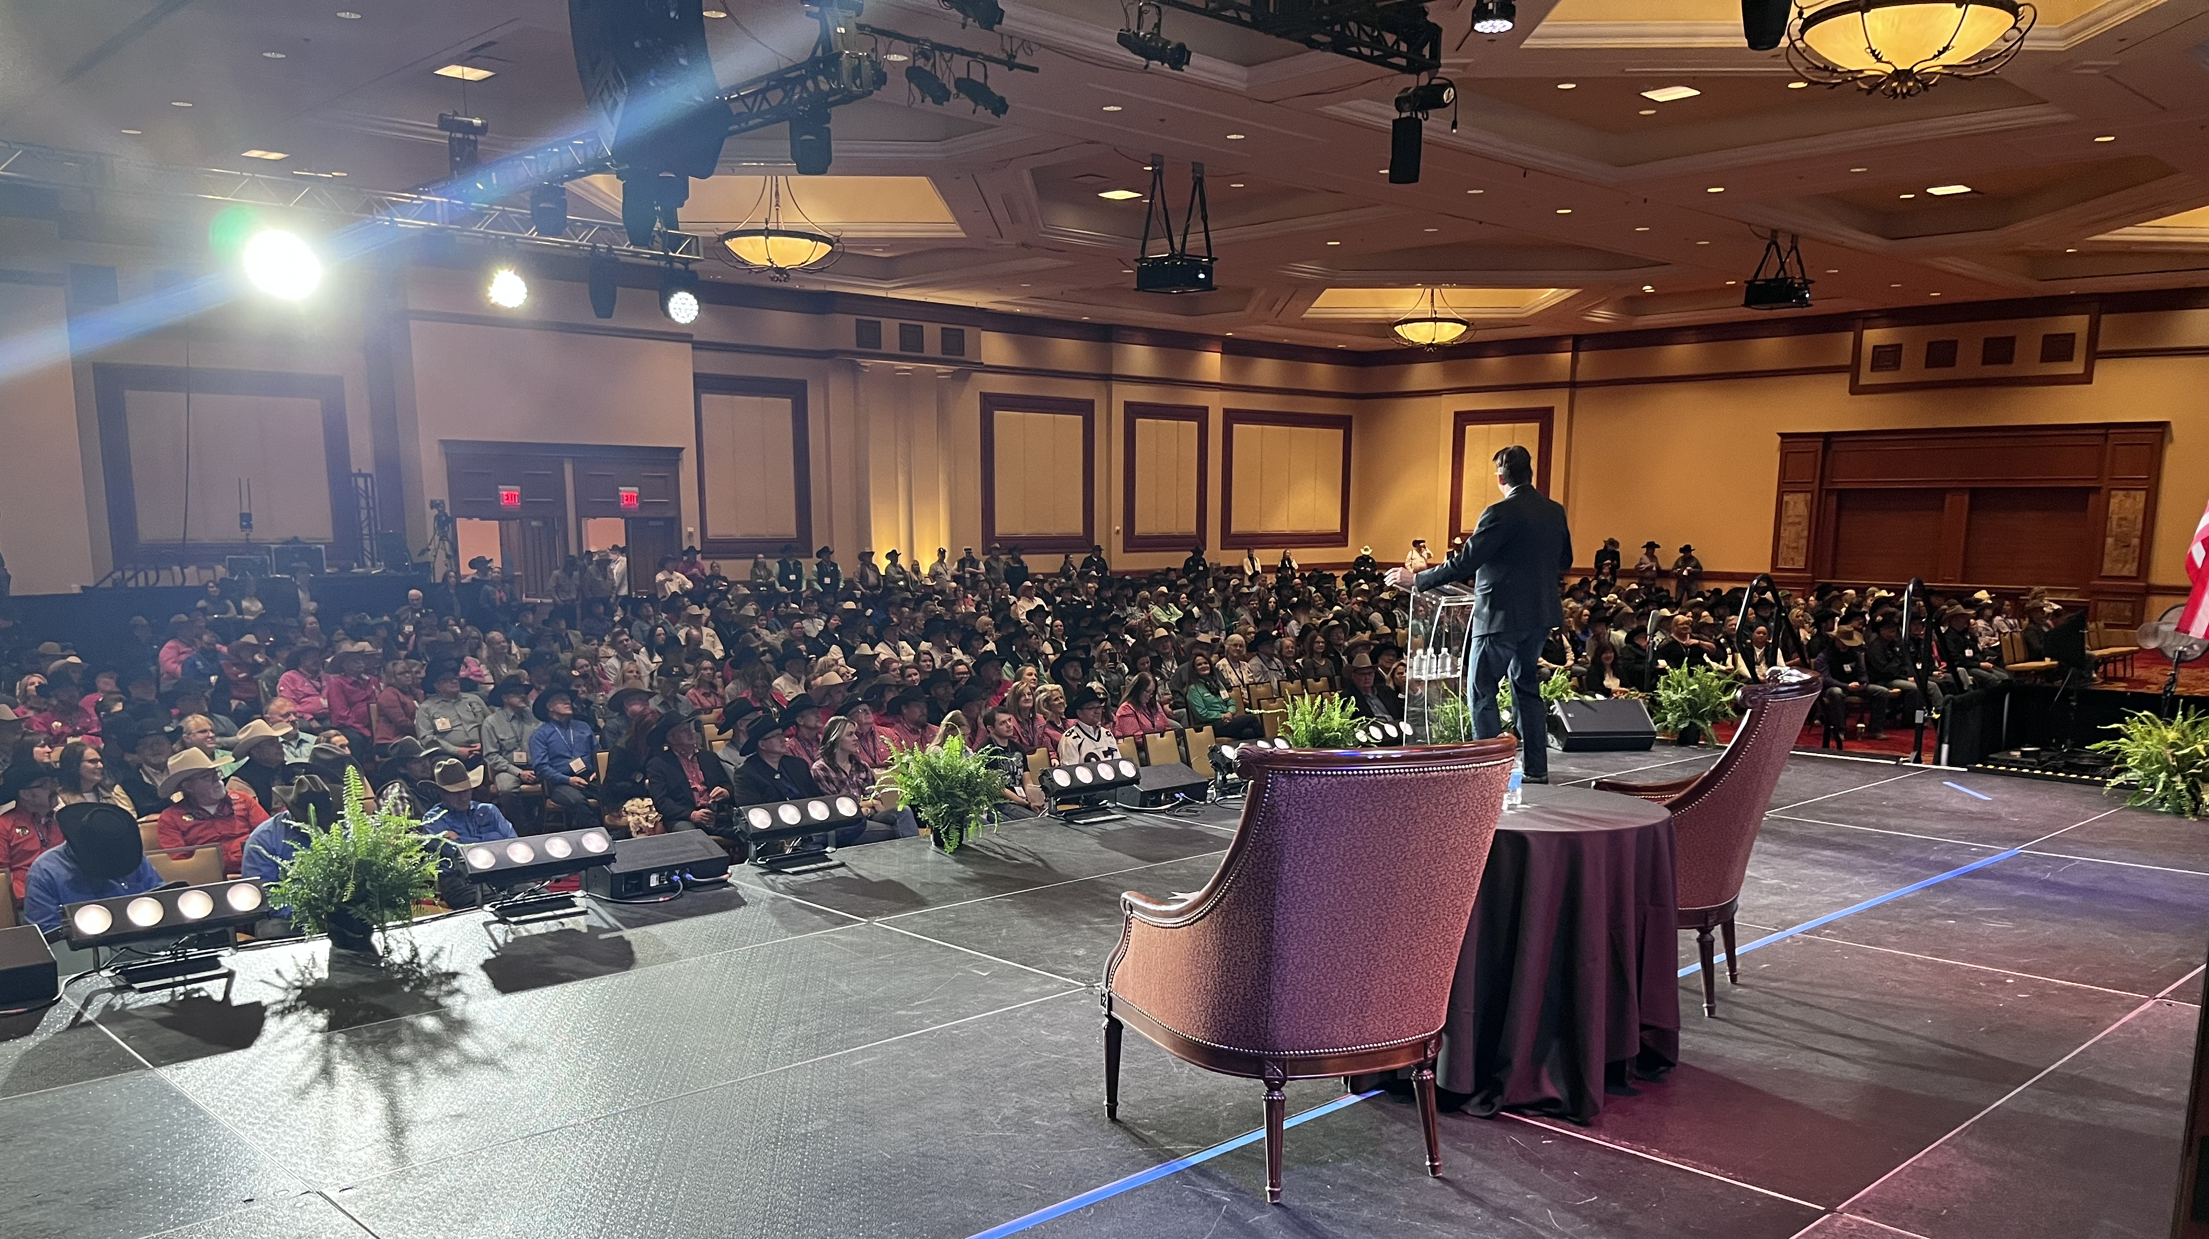
WRAP UP

Slide 36
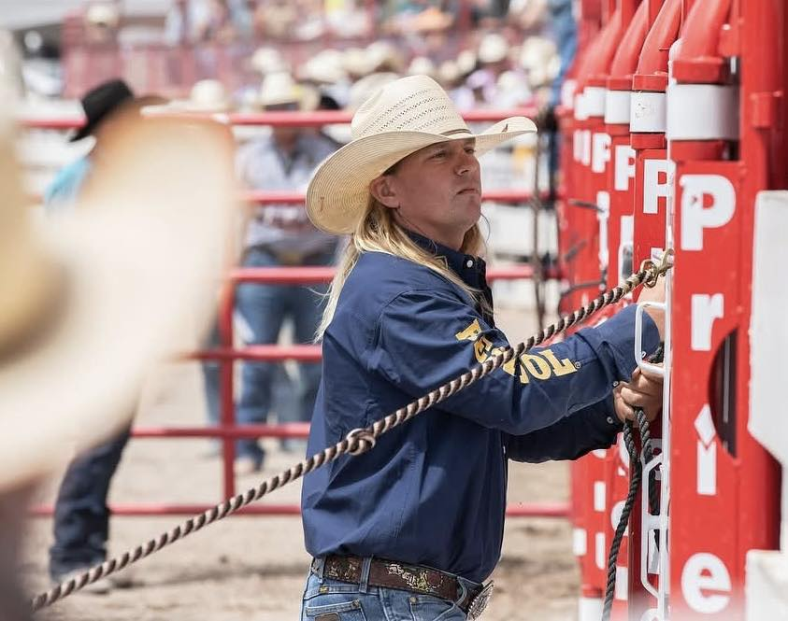
Dylan Terro

